Slide 1




Web Services Advanced
Web Services Types, SoapUI
QA
Automation
SoftUni Team
Technical Trainers
Software University
http://softuni.bg

Slide 2

Table of Contents
Groovy Script
SoapUI Groovy Steps
Test Runner and Context
Get and Set properties
Data Driven Testing
Load Tests

Slide 3
Have a Question?
sli.do #QA-Automation

Slide 4

Groovy Script
Basic

Slide 5

What is Groovy Script?
Apache Groovy is an programming language for the Java platform
It can be used as a scripting language for the Java Platform

Slide 6
Features of Groovy
Support for both static and dynamic typing.
Support for operator overloading.
Native syntax for lists and associative arrays.
Native support for regular expressions.
Native support for various markup languages such as XML and HTML.
You can use existing Java libraries.
Groovy extends the java.lang.Object.

Slide 7
Arithmetic Operations
+ Addition operator / String concatenation
– Subtraction operator
* Multiplication operator
/ Division operator
% Remainder operator
Print method
int a = 100;
int b = 200;
int c = a + b;
log.info('Result :' + c);

Slide 8
Conditional Statements
These statements result in true or false based on the logical conditions
int a=100;
int b=200;
if (a > b) {
log.info('B is greater than A');
} else {
log.info('A is greater or both are equal');
}

Slide 9
Ternary Operator
It has two operands such as question mark (TRUE) and colon (FALSE)
def A = 100
def B = (A > 100) ? 'PASS' : 'FAIL'
log.info(B)

Slide 10
Switch Case
This statement allows multiple conditional branches with different values
def country = 'Bulgaria'
switch(country) {
case "Japan":
log.info('Country matched with 1st case'); break;
case "Bulgaria":
log.info('Country matched with 2st case'); break;
default:
log.info('None of the matches available');
}

Slide 11
Loops
For loop
While loop
for ( int i=1; i<=10; i++ ) {
log.info('Loop iterated' + i + 'times');
}
int a = 1;
while (a < 10) {
log.info('Loop iterated' + a + 'times');
a++;
}
Equals to a = a + 1;

Slide 12
Loops
For loop
While loop
for ( int i=1; i<=10; i++ ) {
log.info('Loop iterated' + i + 'times');
}
int a = 1;
while (a < 10) {
log.info('Loop iterated' + a + 'times');
a++;
}
Equals to a = a + 1;

Slide 13
Arrays
While declaring arrays we must specify the initial size otherwise it will throw a compile error
ArrayObj = new Object [5];
ArrayObj[0] = 'Testcase1';
ArrayObj[1] = 'Testcase2';
ArrayObj[2] = 'Testcase3';
ArrayObj[3] = 'Testcase4';
ArrayObj[4] = 'Testcase5';

Slide 14
Classes and Objects
An object is an instance of a class which consists of properties and methods also it is represented as blue print of the class
class <class name>
{
[access modifiers:]
<properties declaration>
<methods>
}

Slide 15
Methods
def countryName = "Bulgaria";
def cityName = "Sofia";
void CreateProperties(String countryName, String cityName) {
com.eviware.soapui.SoapUI.globalProperties
.addProperty("CountryName")
com.eviware.soapui.SoapUI.globalProperties
.addProperty("CityName")
}
CreateAndPassProperties(countryName, cityName)
log.info("Testcase execution is completed successfully.")

Slide 16
Exceptions
Runtime exception
Compile time exception – not applicable to SoapUI as it does not have an explicit compiler
try {
<code to be executed>
} catch <exception name> {
<exception handler>
} finally {
<default statements>
}

Slide 17

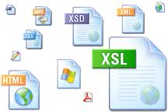

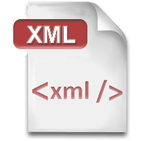




RESTful
Representational State Transfer

Slide 18

XML
XML is markup-language for encoding documents in machine-readable form
Text-based format
Consists of tags, attributes and content
Provide data and meta-data in the same time
<?xml version="1.0"?>
<library>
<book><title>HTML 5</title><author>Bay Ivan</author></book>
<book><title>WPF 4</title><author>Microsoft</author></book>
<book><title>WCF 4</title><author>Kaka Mara</author></book>
</library>

Slide 19
JSON (JavaScript Object Notation)
Standard for representing simple data structures and associative arrays
Lightweight text-based open standard
Derived from the JavaScript language
{
"firstName": "Bay",
"lastName": "Ivan",
"age": 79
}

Slide 20

RSS (Really Simple Syndication)
Family of Web feed formats for publishing frequently updated works
Based on XML, with standardized XSD schema
RSS documents (feeds) are list of items
Each containing title, author, publish date, summarized text, and metadata

Slide 21
RSS Example
<?xml version="1.0" encoding="utf-8" ?>
<rss version="2.0">
<channel>
<title>W3Schools Home Page</title>
<link>http://www.w3schools.com</link>
<description>Free web building tutorials</description>
<item>
<title>RSS Tutorial</title>
<link>http://www.w3schools.com/rss</link>
<description>New RSS tutorial on W3Schools</description>
</item>
</channel>
</rss>

Slide 22
SoapUI Properties
In regard to functional testing properties are used to parameterize the execution and functionality of your tests
Properties types:
Project
TestSuite
TestCase

Slide 23
testRunner Object
Entry-point to the SoapUI API for accessing project items
Abort the ongoing TestCase when an error occurs
Transfer execution to another step
testRunner.fail(...)
testRunner.gotoStepByName(...) testRunning.runTestStepByName( ... )

Slide 24
Accessing Property via Groovy Script
Test case property
Test suite property
def getTestCasePropertyValue =
testRunner.testCase.getPropertyValue("LocalPropertyName")
def getTestSuitePropertyValue = testRunner.testCase.testSuite.getPropertyValue ("LocalPropertyName")

Slide 25
Accessing Property via Groovy Script (2)
Project property
Global property
def getProjectPropertyValue =
testRunner.testCase.testSuite.project.getPropertyValue
("LocalPropertyName")
def getGlobalPropertyValue =
com.eviware.soapui.SoapUI.globalProperties.getPropertyValue ("GlobalPropertyName")

Slide 26
Setting Property via Groovy Script
Set properties
testRunner is common object which might be test suites, test cases or project
testRunner.testCase.testSuite.project.setPropertyValue( "LocalPropertyName", someValue)
com.eviware.soapui.SoapUI.globalProperties.setPropertyValue( "GlobalPropertyName", someValue)

Slide 27
Setting Property via Groovy Script
Set properties
testRunner is common object which might be test suites, test cases or project
testRunner.testCase.testSuite.project.setPropertyValue( "LocalPropertyName", someValue)
com.eviware.soapui.SoapUI.globalProperties.setPropertyValue( "GlobalPropertyName", someValue)

Slide 28
Setting Property via Groovy Script
Set properties
testRunner.testCase.testSuite.project.setPropertyValue( "LocalPropertyName", someValue)
com.eviware.soapui.SoapUI.globalProperties.setPropertyValue( "GlobalPropertyName", someValue)

Slide 29
context Object
Store values that can be used in subsequent test steps or related scripts
def response = context.expand('${ServiceRequest#Response}')
testRunner.testCase.setPropertyValue("Response", response )
def getLocalPropValue = testRunner.testCase.getPropertyValue("Response")
log.info(getLocalPropValue)

Slide 30
Get Response Data
def response = context.expand( '${ServiceRequest_Currency
Converter_1#Response}' )
def parsedResponse = new XmlSlurper().parseText(response)
String convertedValue = parsedResponse.Body
.ConversionRateResponse.ConversionRateResult.text()
log.info(convertedValue)

Slide 31
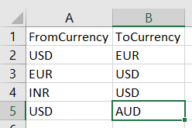
Data Driven Testing
Reading test data through the test scripts for and iterating execution multiple times is known as data driven testing
Data can be passed by:
Excel Files
CSV Files
ODBC Sources
SQL / ADO Objects

Slide 32
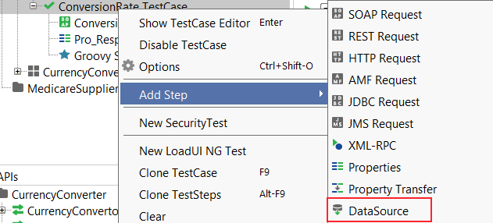

Example
Add Data Source step
Create data loop when SoapUI ask for it
Select request, for which you want to crea DDT

Slide 33
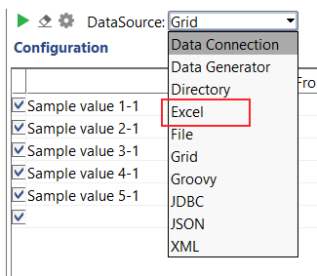
Example
Select this Data Source step
Select Data Source - Excel
Prepare xlsx file

Slide 34
Example
Select this Data Source step
Select Data Source - Excel
Prepare xlsx file and add it to step
You need to specify sheet and start cell

Slide 35

Summary
Groovy Script
SoapUI Groovy Steps
Test Runner and Context
Get and Set properties
Data Driven Testing
Load Tests

Slide 36







Service Testing Advanced
https://softuni.bg/courses/

Slide 37
License
This course (slides, examples, demos, videos, homework, etc.) is licensed under the "Creative Commons Attribution-NonCommercial-ShareAlike 4.0 International" license

Slide 38





Free Trainings @ Software University
Software University Foundation – softuni.org
Software University – High-Quality Education, Profession and Job for Software Developers
softuni.bg
Software University @ Facebook
facebook.com/SoftwareUniversity
Software University @ YouTube
youtube.com/SoftwareUniversity
Software University Forums – forum.softuni.bg

